Slide 1

DELHI TECHNOLOGICAL UNIVERSITY (Formerly Delhi college of engineering)
HOSPITAL MANAGEMENT SYSTEM
USING PRIORITY SCHEDULING
SSSD
SUBMITTED BY: SUBMITTED TO:
AMRUTHA MANIKANDAN (2K20/IT/20) Ms. MEENAKSHI SRIVASTAVA
ANKIT KUMAR (2K20/IT/24)

Slide 2
ABSTRACT
In traditional healthcare queue management systems, all patients are considered to be in the same priority. Since human lives are important, the proposed method resolves the issue by giving priority to patients who are already in worse conditions. The application prioritizes patients to receive their services according to their health and vital status, and then optimize the visit schedule of patients using the Priority scheduling algorithm.

Slide 3
INTRODUCTION
This Hospital Management System uses the Non-Preemptive Priority scheduling algorithm in order to prioritize patients. Each of the four departments – General, Cardiology, General Surgery and Radiology – are given options for two kinds of patients- Normal and Critical. Depending on whether a patient is normal or critical, their meeting with the doctor is prioritized.
In the Non Preemptive Priority scheduling, the processes are scheduled according to the priority number assigned to them. Once the process gets scheduled, it will run till the process gets executed completely. The process with higher priority is executed first followed by the next process with the highest priority.

Slide 4
LITERATURE REVIEW
In this part of the research, several articles and researches on the scheduling of patients' turns in health centers have been reviewed.
According to the studies and research conducted in paper [1], question of classical appointment schedules were studied, which most experts encounter in the processes or health care. In such an environment, an appointment refers to a period that determines the moment at which a customer or patient enters on time. Ideally, the scheduling is in such a way that the patient has no waiting time and the doctor does not have time for idleness. Unfortunately, this state will never be realized, because some factors such as the treatment time for each patient are not constant and is a random variable. Author is trying to find the best appointment schedule to minimize waiting and idleness times for all patients.
In another study [2], the sonography section of a super-specialized clinic was designed to evaluate patients' service delivery and optimal facilities. The performance criteria of queuing system such as waiting time of patient in the queue, calculation of queue length, the duration of service-giving, and other factors are calculated using simulation. The results show that increased service in this case study leads to significant improvement in queuing system.

Slide 5
Another thesis [3] stated that one area in which patients are often dissatisfied is about the time they are waiting for their examination by a doctor. This study first analyses the outpatient clinic to investigate the causes of waiting time and its ranking, which provides weekly sessions based on which the highest waiting times can be found. In this dissertation, by using appointment rules, which were optimized by using simulations and local search methods, new schedules for clinic were significantly developed focusing on reducing the patient's waiting times.
Another paper[4], by the help of analyzing data, general information about data set and type of data were obtained. Then the stages of implementation and execution of the model were described in the environment of Visual Studio and SQL Server software. Then, the way of implementing the genetic algorithm for optimizing the queuing of patients was described.

Slide 6
PROBLEM STATEMENT
The motive of this project is to build a Hospital Management System that fixes appointments of patients with doctors based on the severity of their ailment. The project uses Non-Preemptive Priority Scheduling algorithm for this purpose. Patients are categorized into Normal and Critical patients. The normal patients are queued and consult the doctor one after the other. On the arrival of a critical patient in the queue all the normal patients are made to wait until the critical patient has been attended since the critical patient has a higher priority.

Slide 7
OBJECTIVE
The objective is to create a C++ application for Hospital Management System using Priority Scheduling algorithm. The user can store the details of the patients and decide which patient consults the doctor first depending on their priority.

Slide 8
PROPOSED METHODOLOGY
The physical data structure used in this project is Linked List and the logical data structure is Queue.
A class Patient has been used to store the details of patients.
A class linkedqueue has been used to store the functions and variables required for implementation .
This class contains six functions-
(a) input() – this function accepts personal details as input from the user
(b) search()- this function is used to check if a data is already present in the queue
(c) insertatbeg()- this function is used to insert the new record at the beginning of the queue if it is of a higher priority
(d) insertatend()- this function is used to insert the records of the normal patients one after the other

Slide 9
(e) getpatientout()- this function is used to remove the patient from the queue once attended by the doctor
(f) listofpatients()- this function is used to display the list of patients currently in the queue
A department array is used to store the names of the departments.
The user selects one of the four departments available. On selecting, he/she gets the option to select if the patient is a normal patient or a critical patient. Further the personal details of the patient are stored. The next patient is stored with the second priority and so on. Meanwhile, if a critical patient arrives, he/she is added to the beginning of the queue followed by the next critical patient. It is only after all the critical patients have been attended that the normal patients resume to consult the doctor.
As the patients consult the doctor they are removed the queue. The user is also given the provision to view the details of the patients in queue as per their priority.

Slide 10
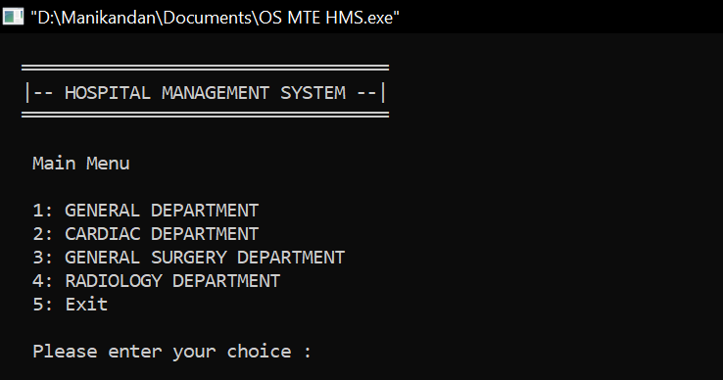
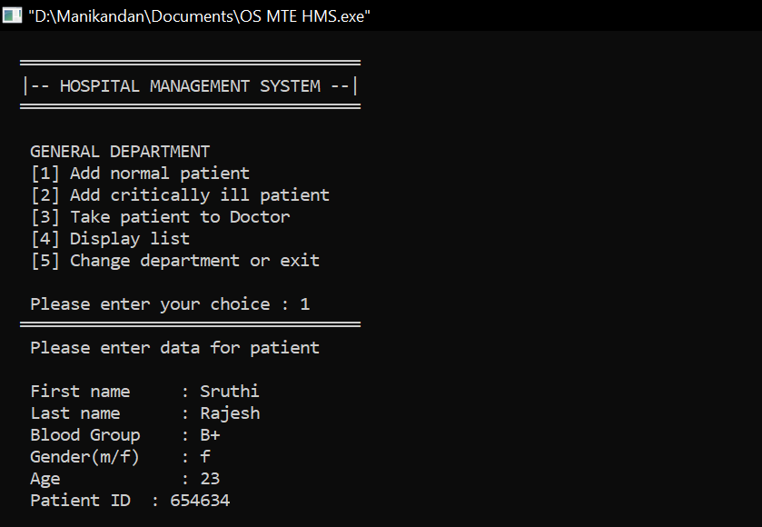
RESULTS

Slide 11
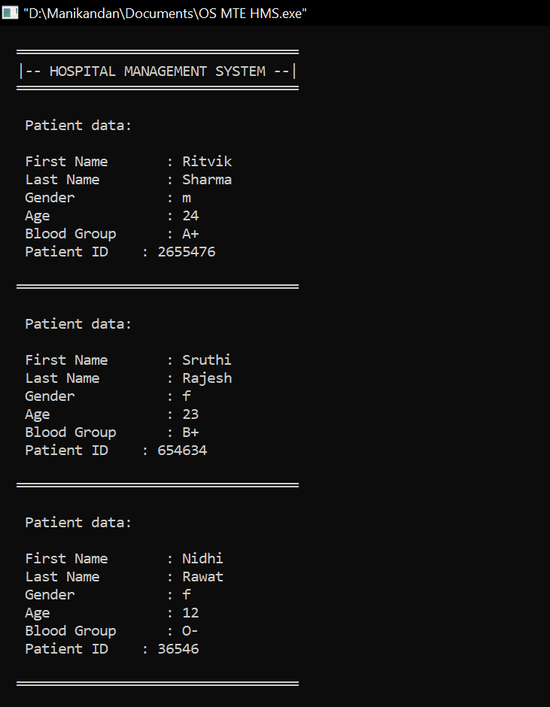
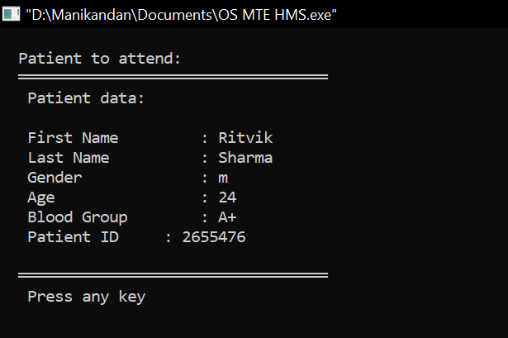

Slide 12
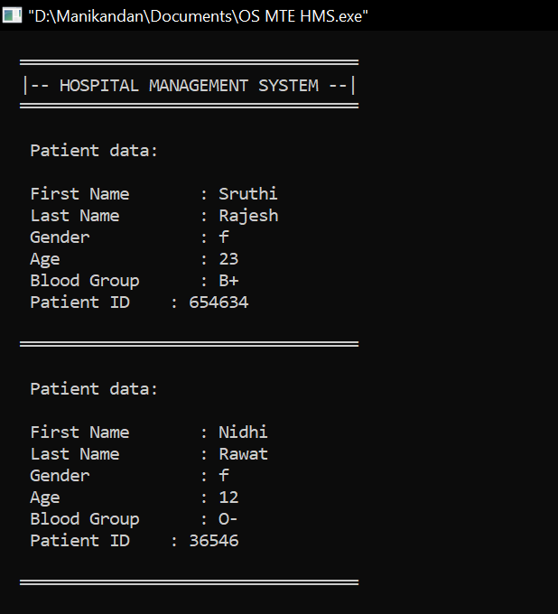
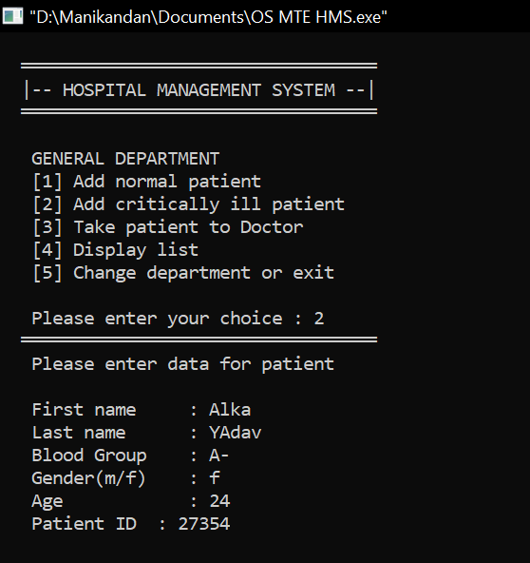
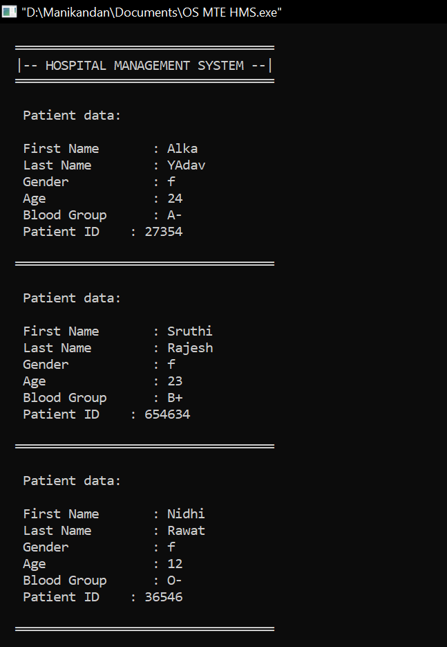

Slide 13
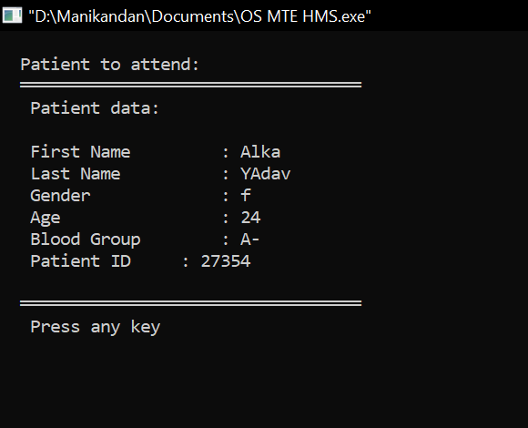
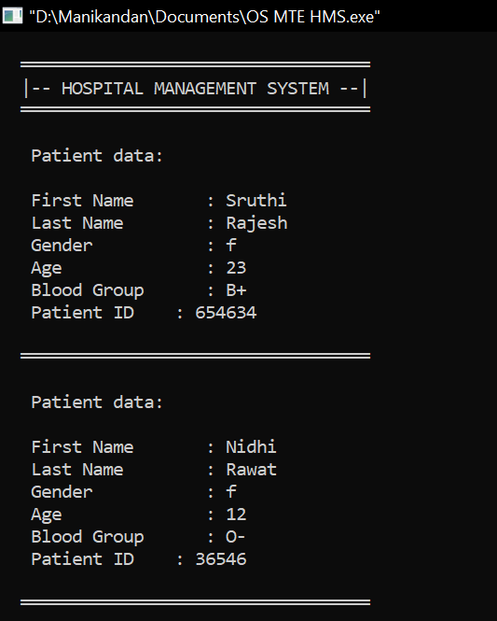
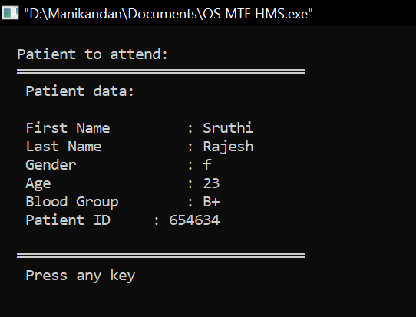

Slide 14
FUTURE SCOPE
Priority scheduling algorithm in Operating System leads to starvation of processes with lower priorities. However in real life the case is different. There will be no many people who are critical and will have to wait for their turn. Also since not just one hospital will exist in a area, there is always an option to seek treatment in another hospital. Hence in real life people will not have to wait for very long for their turns. Hence, this application is suitable for scheduling consultations of patients with their respective doctors.

Slide 15
CONCLUSION
This project represents a typical real world situation and hence it has helped us gain insight into the working of a hospital. Despite of all efforts to make a complete and flawless system, information systems still do not meet all the needs of the users and patients’ satisfaction. One of the most important and challenging issues in health information systems are scheduling and planning of patients’ visits. In this project we have tried to implement a simple C++ application to schedule the consultation of patients using Priority Scheduling algorithm.

Slide 16
REFERENCES
Kuiper A, Appointment scheduling in health care, MSc thesis, University of Amsterdam. (2012)
Noorshabani, A, Evaluation and Improvement of Clinical Clinic System Using Simulation, National Conference on Accounting and Management, Shiraz, Sep. 14. (2013)
Strahl P.F J, , Patient appointment scheduling system with supervised learning prediction, MSc thesis, Aalto University. (2015)
The Optimized Algorithm For Prioritizing And Scheduling Of Patient Appointment At A Health Center According To The Highest Rating In Waiting Queue, IJSTR (2018)
https://www.youtube.com/watch?v=a-IEMoBumRA

